Slide 1
Auto-Suggest: A Minimal Implementation
Soft Reproduction and Evaluation of:
“Auto-Suggest: Learning-to-Recommend Data Preparation Steps Using Data Science Notebooks”
Authors: Cong Yan (University of Washington), Yeye He (Microsoft Research)
Published at: SIGMOD Conference, June 2020, Portland, USA
Replication Study by: Triantafyllos Katsaros & Georgios Xydias (University of Athens)

Slide 2
Data Preparation: Bottleneck for Productivity
Data Preparation is prerequisite for most BI/ML projects today
Involves wrangling raw data into usable formats (e.g. join, reshape, transform, clean …)
Up to 80% of project’s time is spent by users on data preparation
Applies to both expert data scientists and non-technical users
Growing trend: automation & “self-service” data preparation
Rise of tools like Trifacta, Tableau, Microsoft Power Query and others

Slide 3
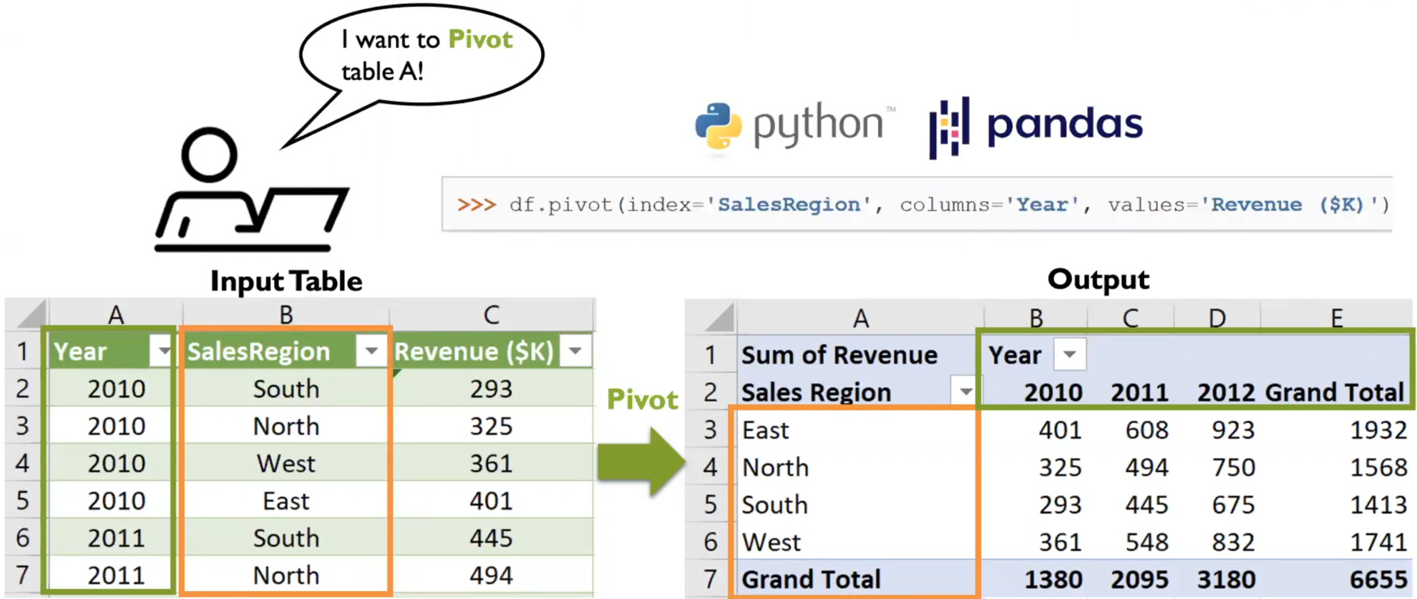
Data Preparation: The “Pivot” Operator as Example

Slide 4
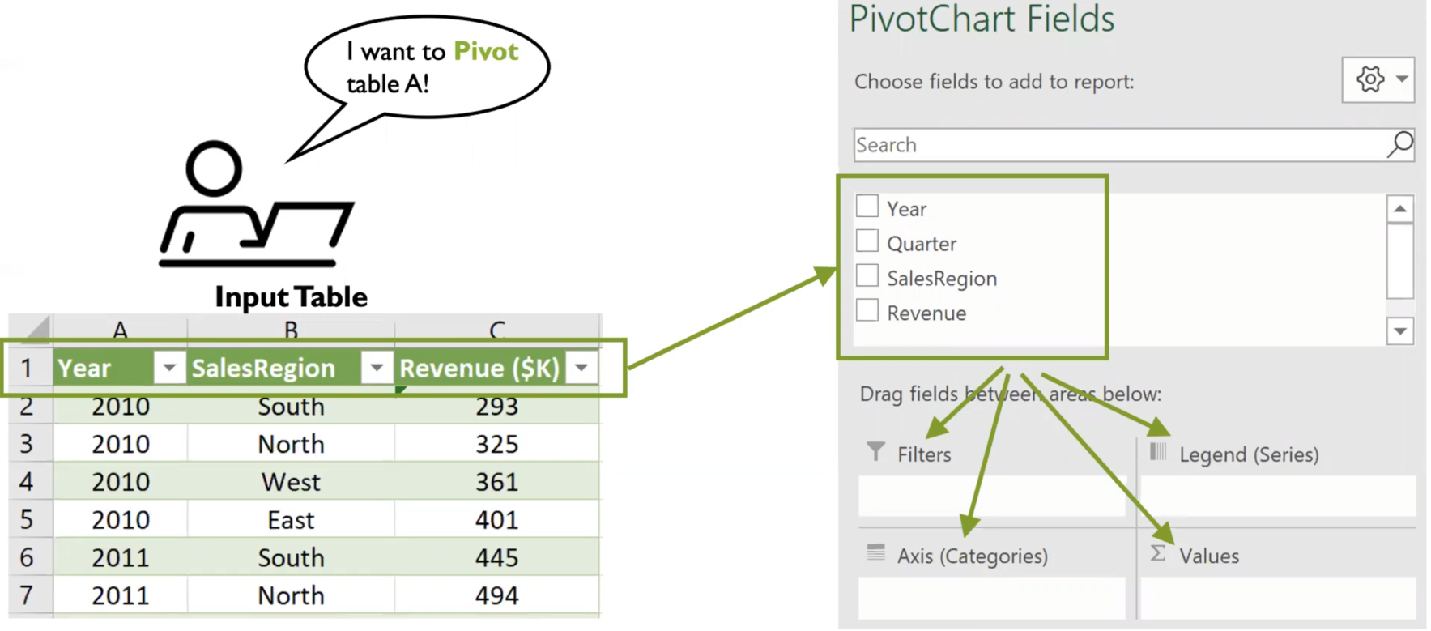
“Pivot”: How would Non-Experts deal with it?

Slide 5
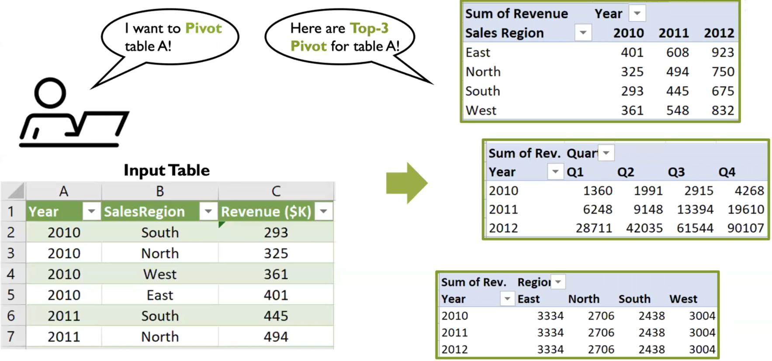
“Pivot”: Intelligent Suggestion of “Top-K Choices”

Slide 6
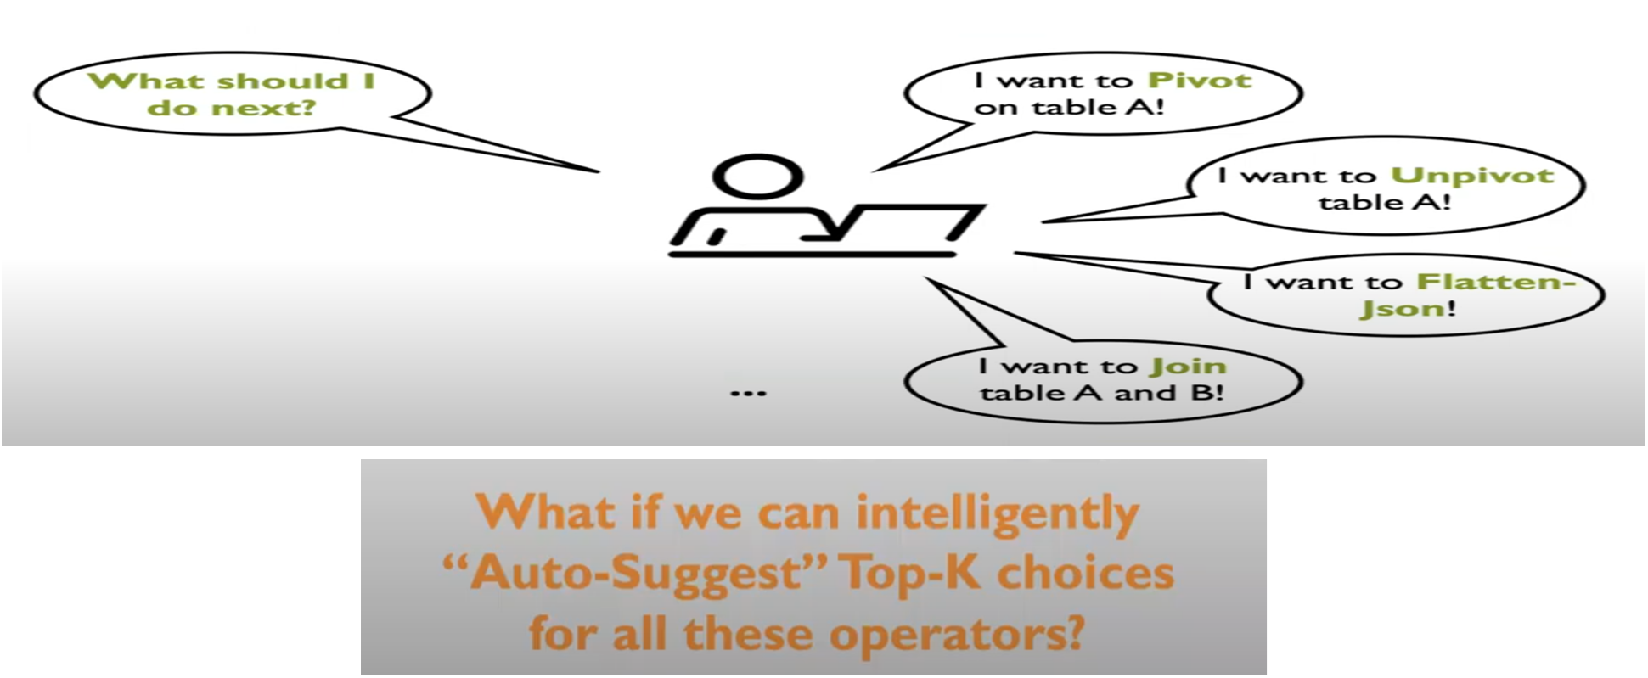
Data Preparation: Many more Challenging Operators

Slide 7
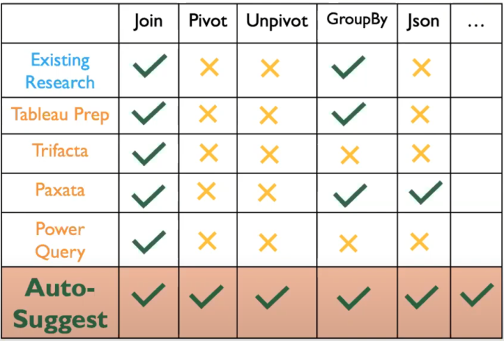

Auto-Suggest: Key Highlights
Limited Support for “Intelligent Suggestion”
Existing research literature and commercial vendors are largely heuristic-based, not accurate
Introducing Auto-Suggest:
Systematic framework to “learn-to-suggest”
“Learns” from 4M+ Jupyter Notebooks
Uses predictive models to “Suggest” appropriate transformations for end-users
Extensible to support additional operators beyond those in existing tools
2 recommendation tasks:
Single-Operator prediction: How to perform a specific operation
Next-Operator prediction: What transformation is likely to come next in the workflow

Slide 8
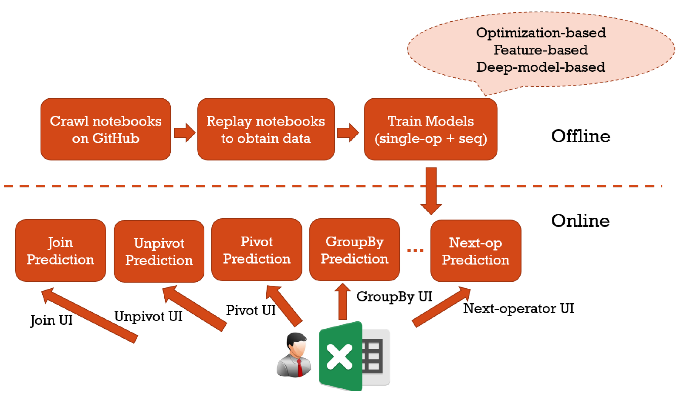
Auto-Suggest System Architecture
Offline Component: Crawls and replays Jupyter notebooks to extract data preparation steps by generating data-flow graphs and training models
Online Component: Delivers real-time recommendations for data preparation steps within interactive environment

Slide 9
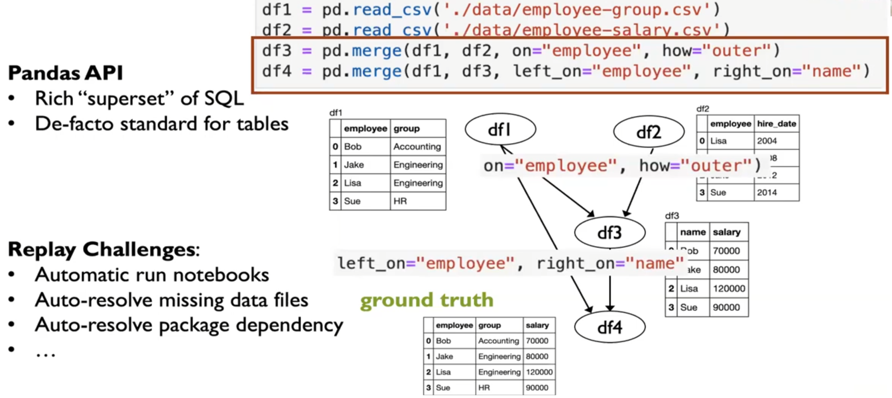
Replay Jupyter Notebooks

Slide 10
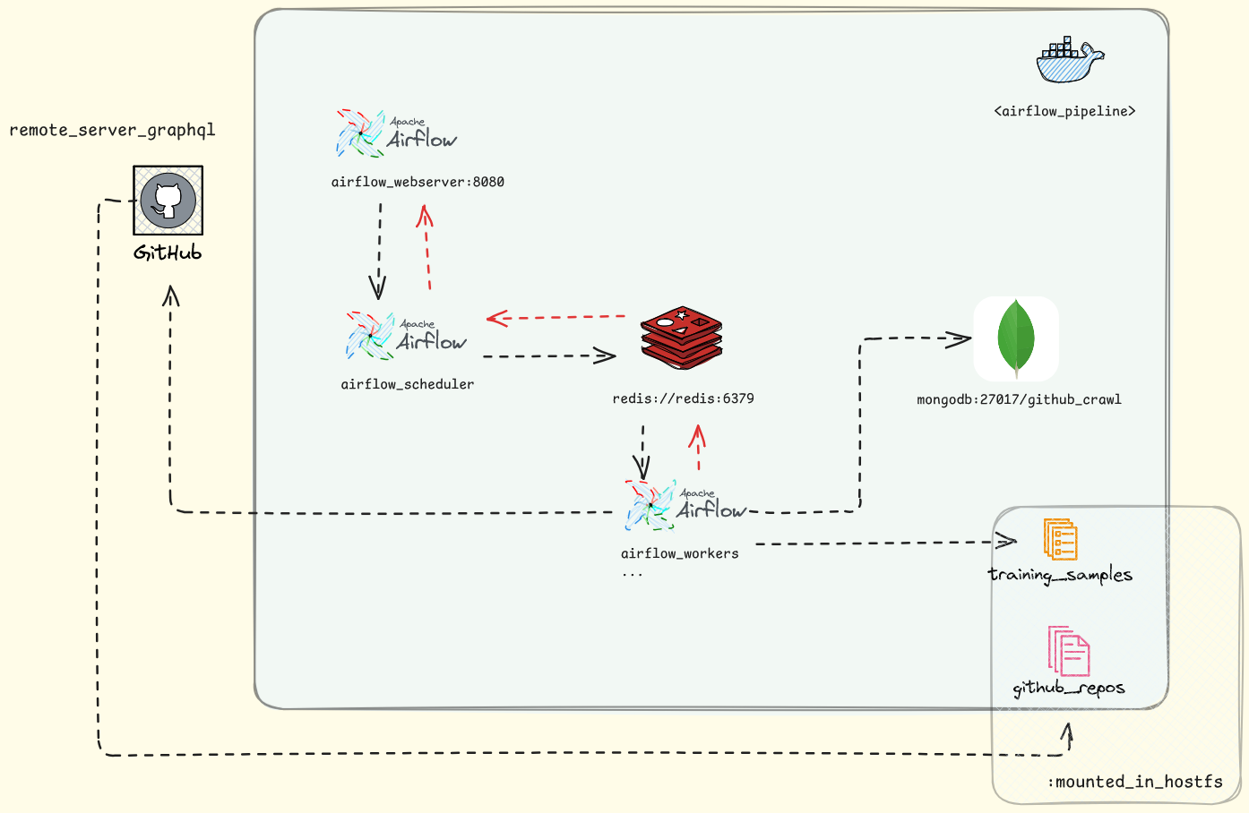
Airflow Architecture for Preprocessing

Slide 11
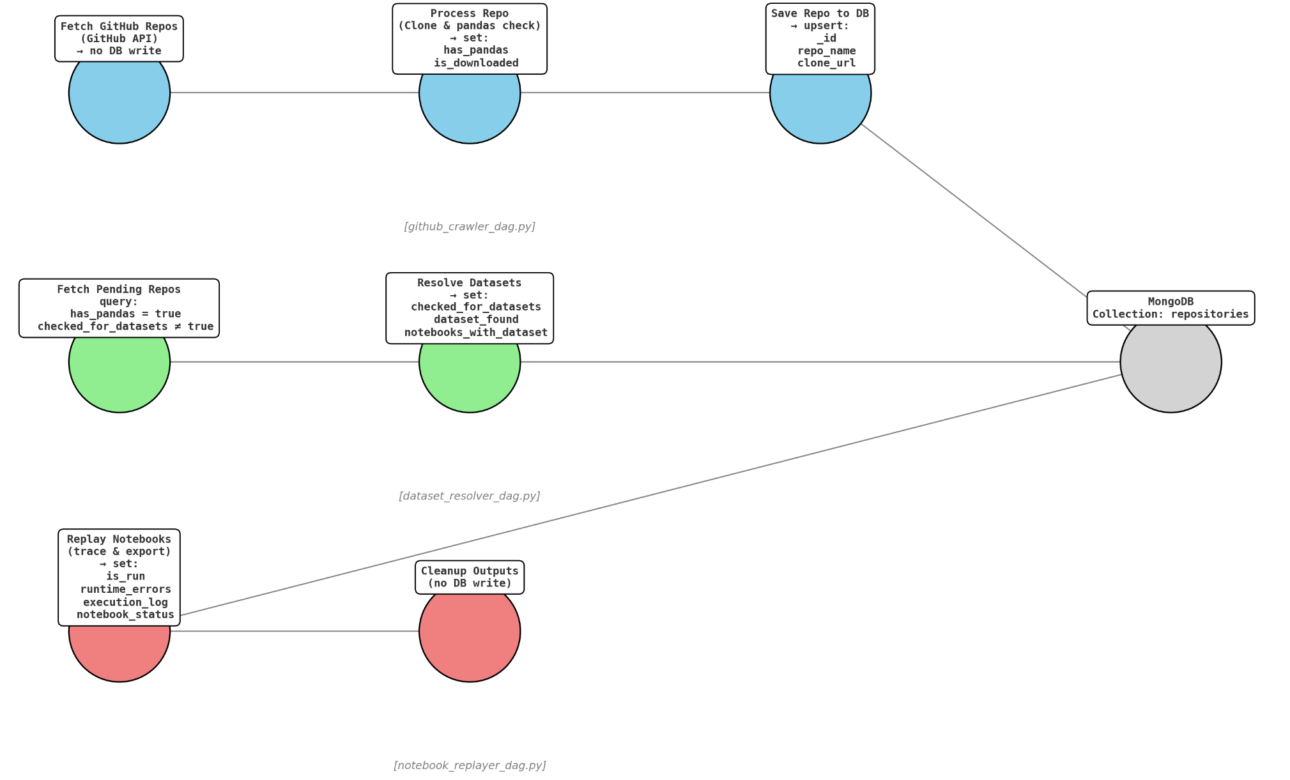
Airflow DAGs workflow

Slide 12
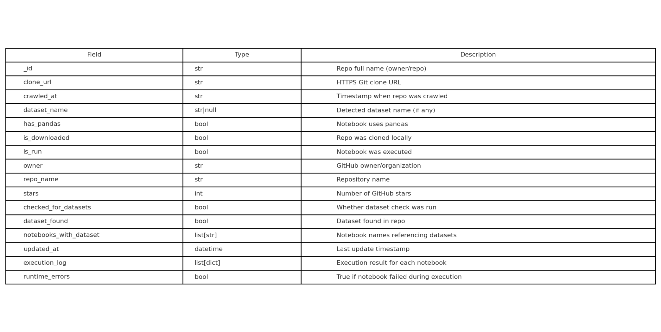
MongoDB Repository Processing State Schema

Slide 13
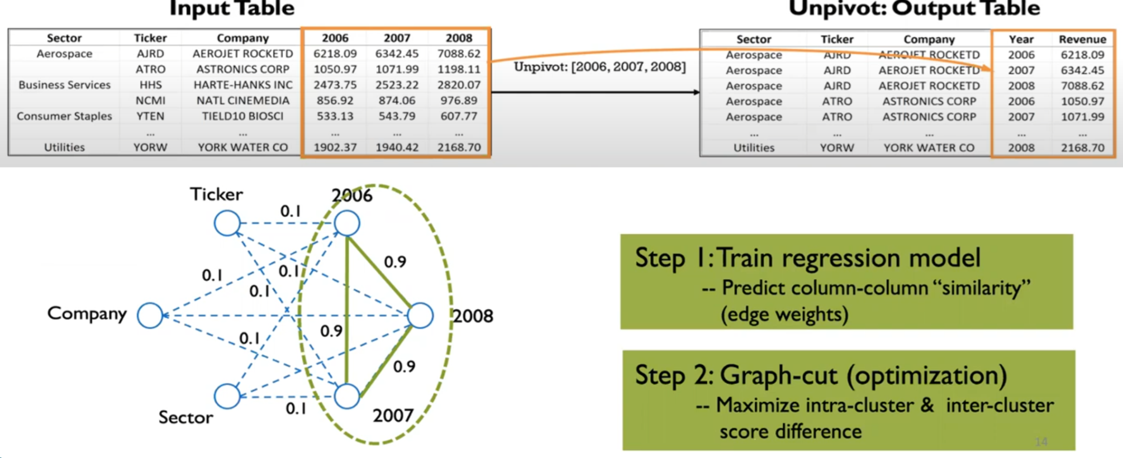
Example: Predict for the “Unpivot” Operator
Task: given input table, predict what columns to “collapse”
Optimization-based formulation: NP-hard problem modeled as a graph cut

Slide 14
Example: Predict for the “Join” Operator
Task: Predict what columns to join and also predict join type (inner, outer, left)
Feature-based model to evaluate join key candidates
Examples of features:
Leftness – whether a column appears early (left) in the table
Emptiness – proportion of missing values
Distinct value ratio – uniqueness of values in each column
Value overlap – Jaccard/containment similarity between column values
…

Slide 15
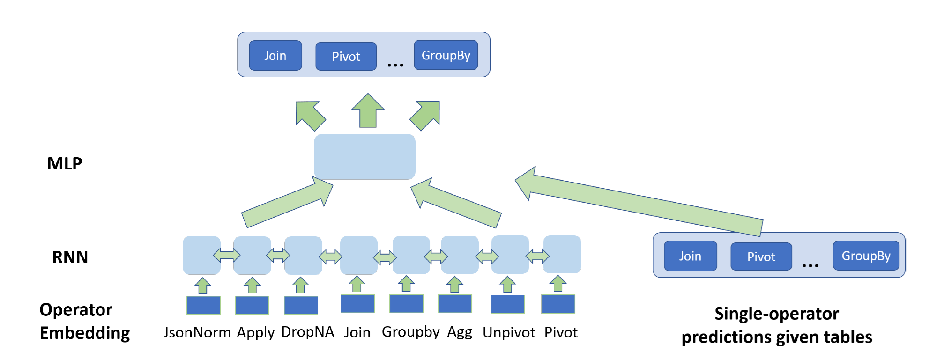
Example: Predict the “Next Operator”
Task: given available tables and operators invoked in the past => predict the most “likely” next operator
Use a model that combines:
A RNN model that learns from past operator sequences
A Single-Operator predictor that evaluates the current table to estimate which operator likelihood
Outputs are fused through a MLP to generate the final prediction

Slide 16
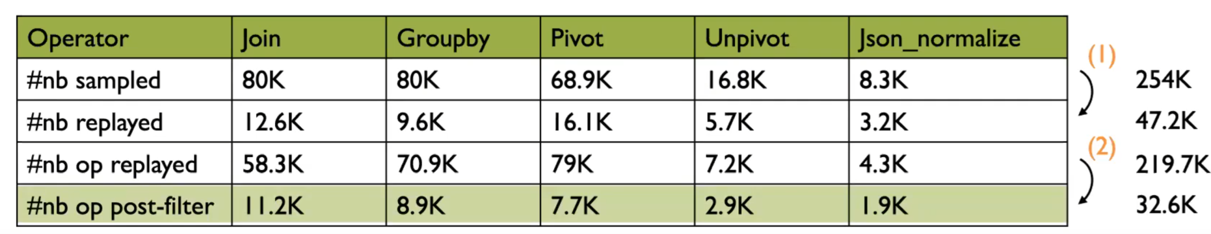
Original Dataset Vs. Ours
Original implementation:
Used 30.7K examples for Join, Groupby, Pivot and Unpivot models
Included 65K operator sequences for next-operator prediction
Highly replay failure rate due to issues like broken code, missing data, … (81.5%)
Filtering removed low-quality cases like large loops, small tables, … (85.2%)
Our soft implementation:
Demonstrated the Replay Notebooks Process using 10 well-structured and replayable dummy notebooks (including data file resolution, operator graph tracking and parameter extraction)
Used a subset of the authors’ dataset of 100 examples per operator (Join, Groupby, Pivot, Unpivot), which did not include sequences
Created 1000 artificial operator sequences to train the sequence models
Combined operator and sequence data to construct a final 400-sample dataset for training the final model

Slide 17
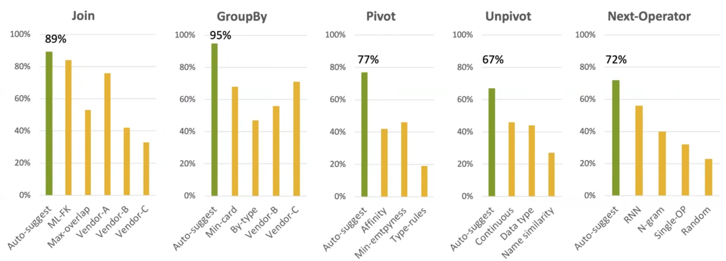
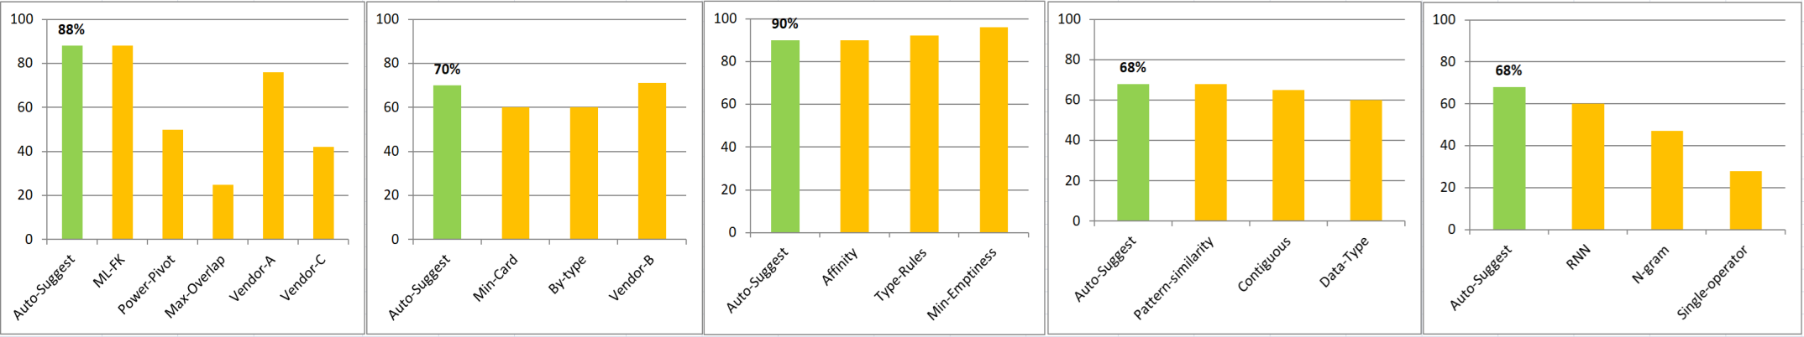
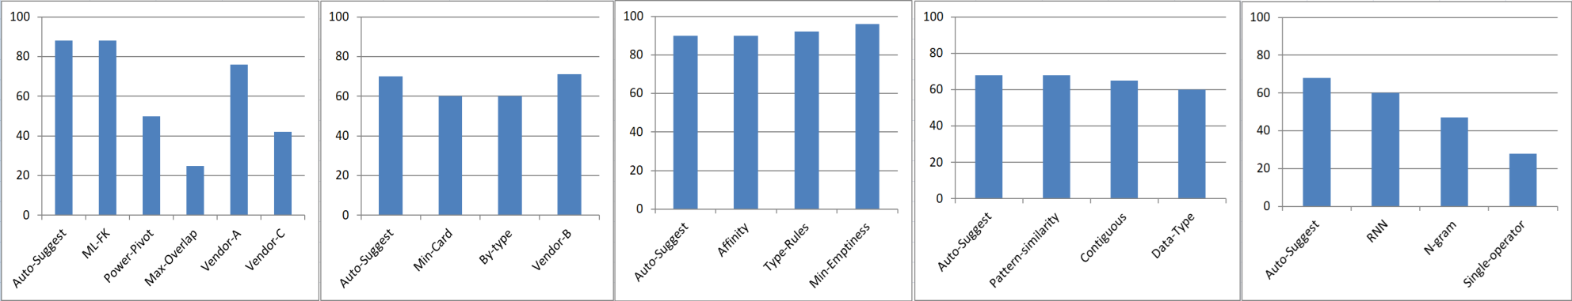
Evaluation: Precision

Slide 18
Conclusion
Soft Implementation of Auto-Suggest for Self-service Data Preparation:
Used a subset of real data preparation tasks from Jupyter notebooks, enhanced with synthetic sequences
Predicted both “single-operator” steps and “next-operator” (Join, Merge, Pivot, Unpivot)
Despite limitations in data and resources, the system achieved decent performance across tasks
Future Work:
Expand data collecting from shared workflows on platforms like Kaggle or Hugging Face
Learn from BI projects, instead of notebooks only (Auto-Prep, VLDB 2025)
Apply similar learning approaches to structured files, e.g. Excel (Auto-Formula, SIGMOD 2024)
Direct successor of auto-suggest is Auto-Pipeline (VLDB, 2021), which automates full data pipelines using Auto-Suggest as a component
Explore domain-specific extensions, e.g. medical notebooks or cancer studies (or apply Auto-Suggest modeling principles beyond just data transformation)

Slide 19
Questions ?
Thank you

